Slide 1
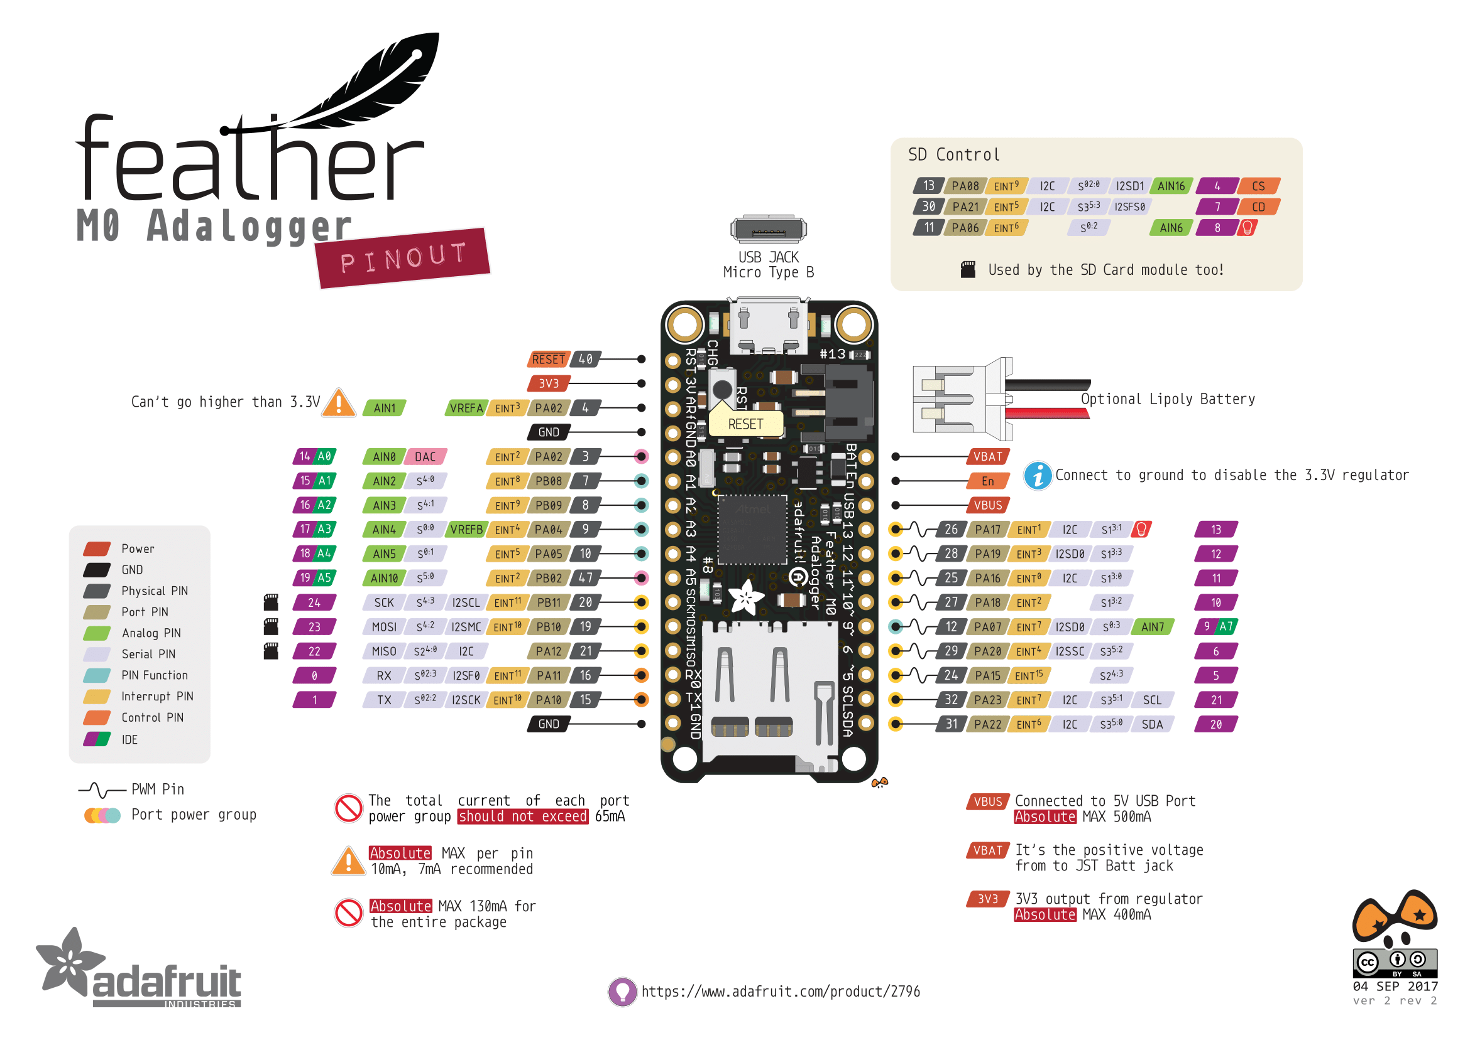
SD_CS (internal)
SD_CD (internal)
SD_LED (internal)
LED_RED (internal)
PW_SERVO
SERVO
PW_RFID
IR_2
IR_1
VBAT (internal)
TEMP_CS
PW_3V
RTC
RTC

